Slide 1

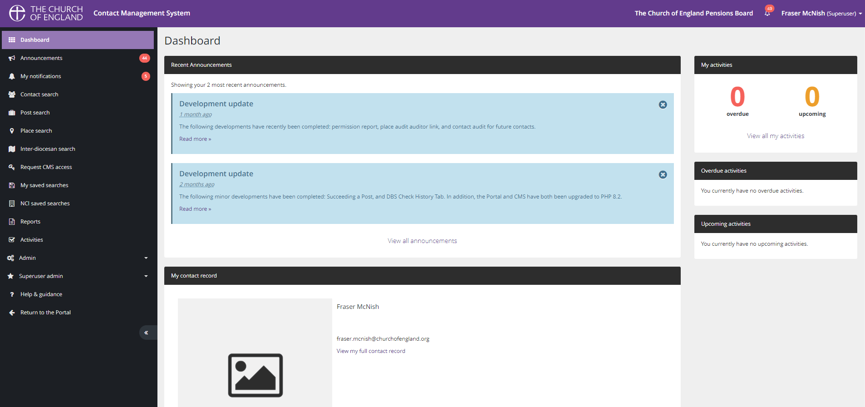
DATA SERVICES
Contact Management System
The Pension Board
Retirement Officer Development
Fraser McNish – Director of Data Services
Strive for excellence | Show compassion | Collaborate | Respect others | Act with integrity

Slide 2
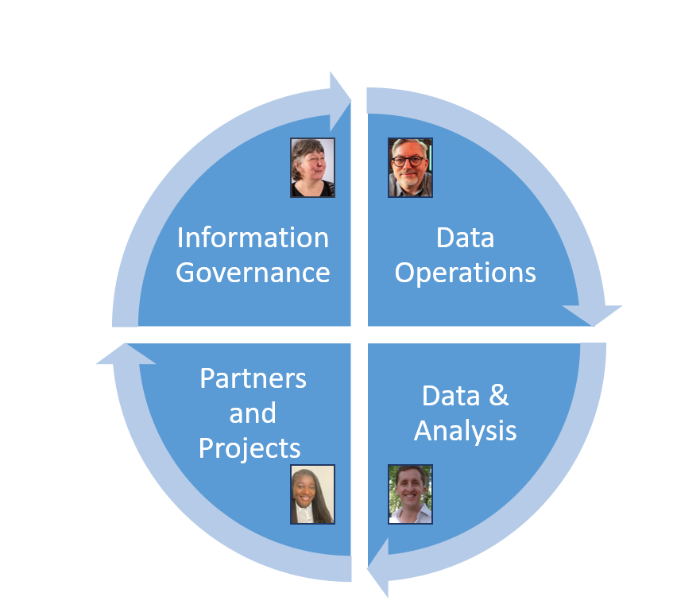
Introduction
DATA SERVICES
Fraser McNish – Director of Data Services
Data Services is a new team brining systems, data collection, analysis & governance into one team
I have been working within the CofE for 24 years
Majority of that time in the Diocese of Southwell & Nottingham with a theme of technology & data
The Last three years in my role shaping the Data Services team
I was seconded to the National Church a day a week to lead the CMS Project
Data Services
Strive for excellence | Show compassion | Collaborate | Respect others | Act with integrity

Slide 3

What is CMS?
DATA SERVICES
Contact Management System
(A Database)
PEOPLE PLACES & ROLES
34/42 Dioceses using this one platform – 3 Joining in 2025
Strive for excellence | Show compassion | Collaborate | Respect others | Act with integrity

Slide 4
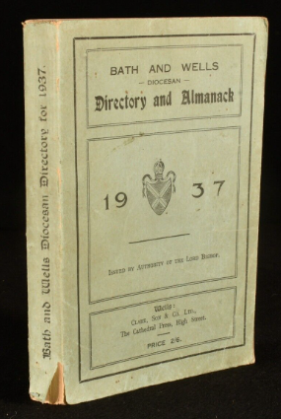
What is it used for
DATA SERVICES
Who remembers the Diocesan Directory?
Electronic Directory
Who is who and where
Connected to the source – APCM process
Communication
  Across all roles in the Diocese (Clergy & Laity)
Storing data against the Person, Place and Role
  Training Records / Safeguarding
  DBS
Strive for excellence | Show compassion | Collaborate | Respect others | Act with integrity

Slide 5
How can it help?
DATA SERVICES
The CMS – Diocese of Southwell & Nottingham
Has a record for Fraser McNish
NAME :Fraser McNish
Email : fraser.mcnish@email.com
Telephone : 01636 817200
Role 1 :Churchwarden – St Mary
Role 2 : Diocesan Synod (House of Laity)
Role 3 : Retirement Officer (AD of Newark)
Strive for excellence | Show compassion | Collaborate | Respect others | Act with integrity

Slide 6
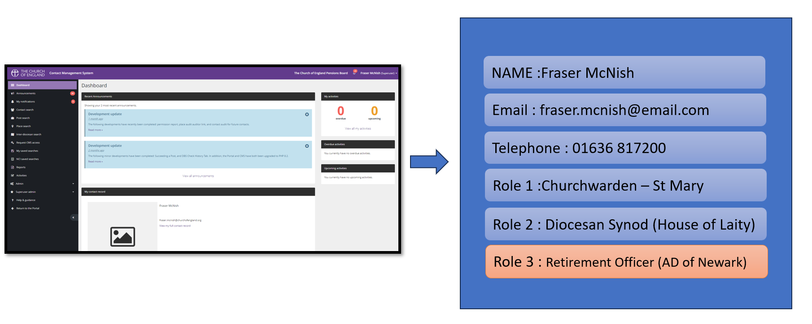


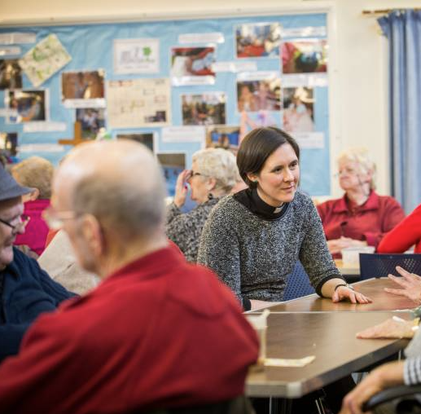
How can it help?
DATA SERVICES
CMS Dioceses The Pensions Board Communication
Live
Data
Strive for excellence | Show compassion | Collaborate | Respect others | Act with integrity

Slide 7
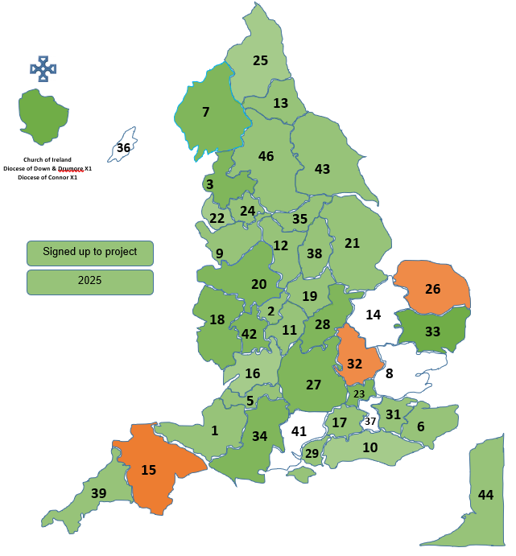
How can you help
DATA SERVICES
If your Diocese is part of CMS, check your Retirement officers are connected to the Pensions Board CMS
Each Diocese has a CMS Superuser
  Ask me if you can't find who it is
A simple tick to connect
If your Diocese is not yet a CMS Diocese – Please encourage it to be
Strive for excellence | Show compassion | Collaborate | Respect others | Act with integrity

Slide 8
DATA SERVICES
Questions
Fraser.McNish@churchofengland.org
Strive for excellence | Show compassion | Collaborate | Respect others | Act with integrity

